Slide 1



Shark: Hive (SQL) on Spark
Reynold Xin

Slide 2
Stage 0: Map-Shuffle-Reduce
Mapper(row) {
fields = row.split("\t")
emit(fields[0], fields[1]);
}
Reducer(key, values) {
sum = 0;
for (value in values) {
sum += value;
}
emit(key, sum);
}
Stage 1: Map-Shuffle
Mapper(row) {
...
emit(page_views, page_name);
}
... shuffle
Stage 2: Local
data = open("stage1.out")
for (i in 0 to 10) {
print(data.getNext())
}

Slide 3
SELECT page_name, SUM(page_views) views
FROM wikistats GROUP BY page_name
ORDER BY views DESC LIMIT 10;

Slide 4
Stage 0: Map-Shuffle-Reduce
Mapper(row) {
fields = row.split("\t")
emit(fields[0], fields[1]);
}
Reducer(key, values) {
page_views = 0;
for (page_views in values) {
sum += value;
}
emit(key, sum);
}
Stage 1: Map-Shuffle
Mapper(row) {
...
emit(page_views, page_name);
}
... shuffle sorts the data
Stage 2: Local
data = open("stage1.out")
for (i in 0 to 10) {
print(data.getNext())
}

Slide 5
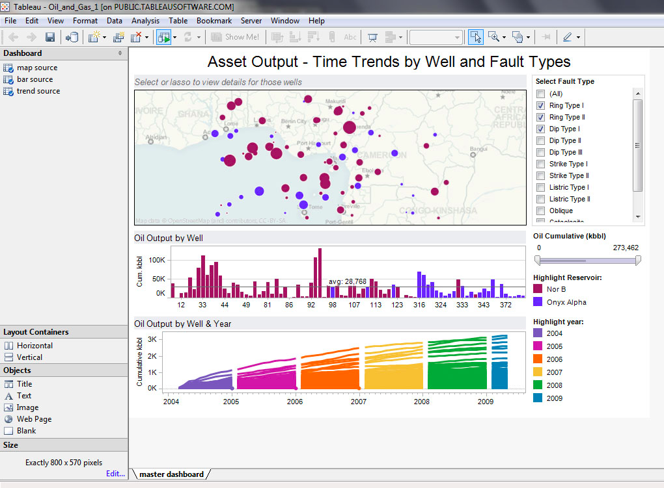
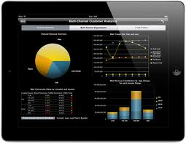
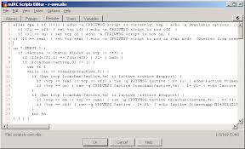

Slide 6
Outline
Hive and Shark
Usage
Under the hood

Slide 7
Apache Hive
Puts structure/schema onto HDFS data
Compiles HiveQL queries into MapReduce jobs
Very popular: 90+% of Facebook Hadoop jobs generated by Hive
Initially developed by Facebook

Slide 8
OLAP vs OLTP
Hive is NOT for online transaction processing (OTLP)
Focuses on scalability and extensibility for data warehouses / online analytical processing (OLAP)

Slide 9
Scalability
Massive scale out and fault tolerance capabilities on commodity hardware
Can handle petabytes of data
Easy to provision (because of scale-out)

Slide 10
Extensibility
Data types: primitive types and complex types
User-defined functions
Scripts
Serializer/Deserializer: text, binary, JSON…
Storage: HDFS, Hbase, S3…

Slide 11
But slow…
Takes 20+ seconds even for simple queries
"A good day is when I can run 6 Hive queries” - @mtraverso

Slide 12
Shark
Analytic query engine compatible with Hive
Supports Hive QL, UDFs, SerDes, scripts, types
A few esoteric features not yet supported
Makes Hive queries run much faster
Builds on top of Spark, a fast compute engine
Allows (optionally) caching data in a cluster’s memory
Various other performance optimizations
Integrates with Spark for machine learning ops

Slide 13


Slide 14
Use cases
Interactive query & BI (e.g. Tableau)
Reduce reporting turn-around time
Integration of SQL and machine learning pipeline

Slide 15
Much faster?
100X faster with in-memory data
2 - 10X faster with on-disk data

Slide 16
Real Workload (1.7TB)

Slide 17
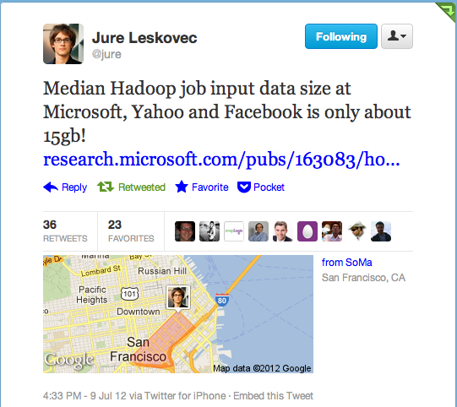

Slide 18
Outline
Hive and Shark
Usage
Under the hood

Slide 19
Data Model
Tables: unit of data with the same schema
Partitions: e.g. range-partition tables by date
Buckets: hash-partitions within partitions (not yet supported in Shark)

Slide 20
Data Types
Primitive types
TINYINT, SMALLINT, INT, BIGINT
BOOLEAN
FLOAT, DOUBLE
STRING
TIMESTAMP
Complex types
Structs: STRUCT {a INT; b INT}
Arrays: ['a', 'b', 'c’]
Maps (key-value pairs): M['key’]

Slide 21
Hive QL
Subset of SQL
Projection, selection
Group-by and aggregations
Sort by and order by
Joins
Sub-queries, unions
Hive-specific
Supports custom map/reduce scripts (TRANSFORM)
Hints for performance optimizations

Slide 22
Analyzing Data
CREATE EXTERNAL TABLE wiki (id BIGINT, title STRING, last_modified STRING, xml STRING, text STRING) ROW FORMAT DELIMITED FIELDS TERMINATED BY '\t' LOCATION 's3n://spark-data/wikipedia-sample/';
SELECT COUNT(*) FROM wiki WHERE TEXT LIKE '%Berkeley%';

Slide 23
Caching Data in Shark
CREATE TABLE mytable_cached AS SELECT * FROM mytable WHERE count > 10;
Creates a table cached in a cluster’s memory using RDD.cache ()
* This “hack” is going away in the next version.

Slide 24
Demo

Slide 25
Spark Integration
Unified system for SQL, graph processing, machine learning
All share the same set of workers and caches

Slide 26
Tuning Degree of Parallelism
SET mapred.reduce.tasks=50;
Shark relies on Spark to infer the number of map tasks (automatically based on input size)
Number of “reduce” tasks needs to be specified
Out of memory error on slaves if num too small
We are working on automating this!

Slide 27
Outline
Hive and Shark
Data Model
Under the hood

Slide 28
How?
A better execution engine
Hadoop MR is ill-suited for SQL
Optimized storage format
Columnar memory store
Various other optimizations
Fully distributed sort, data co-partitioning, partition pruning, etc

Slide 29
Hive Architecture

Slide 30
Shark Architecture

Slide 31
Why is Spark a better engine?
Extremely fast scheduling
ms in Spark vs secs in Hadoop MR
General execution graphs (DAGs)
Each query is a “job” rather than stages of jobs
Many more useful primitives
Higher level APIs
Broadcast variables
…

Slide 32
select
page_name,
sum(page_views) hits
from wikistats_cached
where
page_name like "%berkeley%”
group by page_name
order by hits;

Slide 33

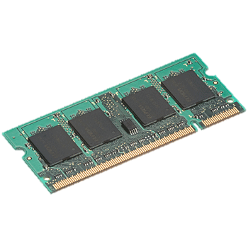
select page_name, sum(page_views) hits
from wikistats_cached
where page_name like "%berkeley%”
group by page_name order by hits;
filter (map)
groupby
sort

Slide 34
Columnar Memory Store
Column-oriented storage for in-memory tables
Yahoo! contributed CPU-efficient compression (e.g. dictionary encoding, run-length encoding)
3 – 20X reduction in data size

Slide 35
Ongoing Work
Code generation for query plan (Intel)
BlinkDB integration (UCB)
Bloom-filter based pruning (Yahoo!)
More intelligent optimizer (UCB & Yahoo! & ClearStory & OSU)

Slide 36
Getting Started
~5 mins to install Shark locally
https://github.com/amplab/shark/wiki
Spark EC2 AMI comes with Shark installed (in /root/shark)
Also supports Amazon Elastic MapReduce
Use Mesos or Spark standalone cluster for private cloud

Slide 37
More Information
Hive resources:
https://cwiki.apache.org/confluence/display/Hive/GettingStarted
http://hive.apache.org/docs/
Shark resources:
http://shark.cs.berkeley.edu

